Slide 1
FHIR Fly-over
FHIR North
Lloyd McKenzie

Slide 2

Who am I?
Name: Lloyd McKenzie
Company: Gevity
Background:
One of FHIR’s 3 initial editors
Co-chair FHIR Management Group and FHIR-Infrastructure
HL7 Fellow
Heavily involved in HL7 and healthcare exchange for last 20 years (v2, v3, CDA, etc.)
lmckenzie@gevityinc.com

Slide 3
Introduction to FHIR

Slide 4

FHIR is…
A new healthcare exchange standard
®
HL7 v2
CDA
®
Notes:
Data from one system to another
- inpatient, outpatient, public health, claims, research, etc.

Slide 5

FHIR is…
A modern, cheaper, faster, more flexible approach
Notes:
Base specification is simple, but allows extensibility
Same schema everywhere, profiles & Igs provide guidance

Slide 6

FHIR is…
A toolbox
140+ resources
20 exchange mechanisms
100s of extensions
>100 IGs

Slide 7


FHIR is…
A platform

Slide 8
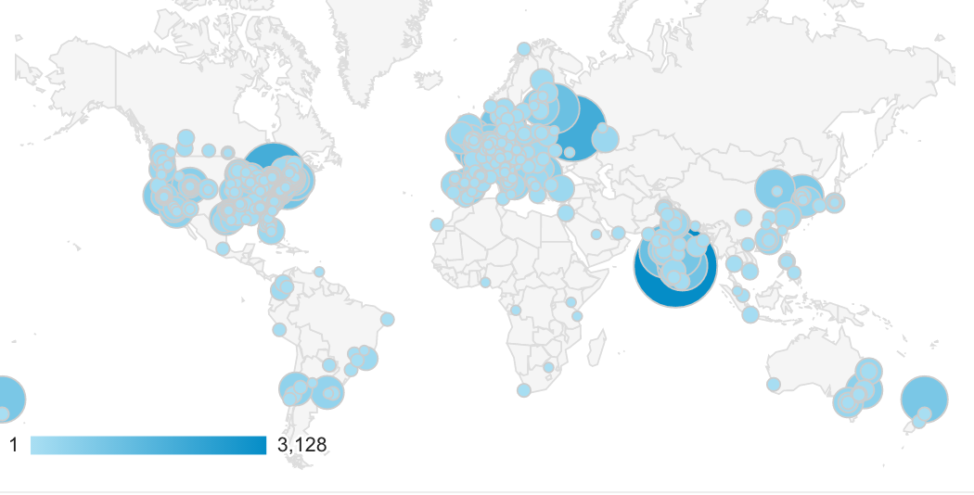
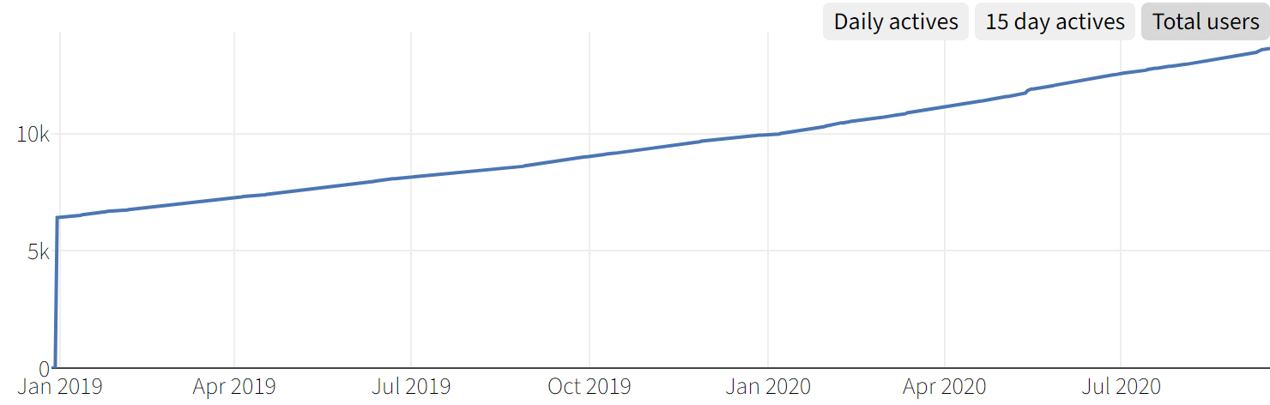







FHIR is…
A vibrant community

Slide 9
Summary
A new healthcare exchange standard
A modern, cheaper, faster, more flexible approach
A toolbox for building interoperability solutions
A platform for healthcare solutions
A vibrant community

Slide 10
Key links
The spec:
http://hl7.org/fhir
The community:
http://chat.fhir.org

Slide 11

Questions / discussion?
lmckenzie@gevityinc.com
(or PM me on http://chat.fhir.org)

